Slide 1
Project Title
Extraction and Analysis of Data
related to Hiring Process in HR-Tech area
- Swarali Paygude, TY Btech CSE

Slide 2
Project Objective
To implement and test modules for data models
To understand text mining
To understand feature extraction and predictive analysis of data related to hiring process in HR-Tech area
To implement employee login system

Slide 3
Theoretical Background
Hardware configuration :
Intel Core i5 x64 processor
8 GB RAM
Keyboard, mouse
Software description :
64-bit Microsoft Windows OS

Slide 4
Theoretical Background
Software Tools used:
Eclipse Java EE IDE
MySQL Workbench 8.0
MySQL Server
DBVisualizer
Postman

Slide 5
Theoretical Background
For keyword detection :
job description as input
searches it for keywords from list of keywords in the database
detected keywords and their number of occurences as output
For employee login system :
two main parts- admin login and user login

Slide 6
Theoretical Background
admin login
add employee
remove employee
update details about employee performance
view list of all existing employees
user login
view all employee details
update personal information
change password

Slide 7
Methodology Followed
For keyword detection :
AWS Lambda project on Eclipse for implementation
jar file uploaded on AWS Lambda
API Gateway created
API created
API deployed to get an API endpoint (URL)
URL used on Postman to check output

Slide 8
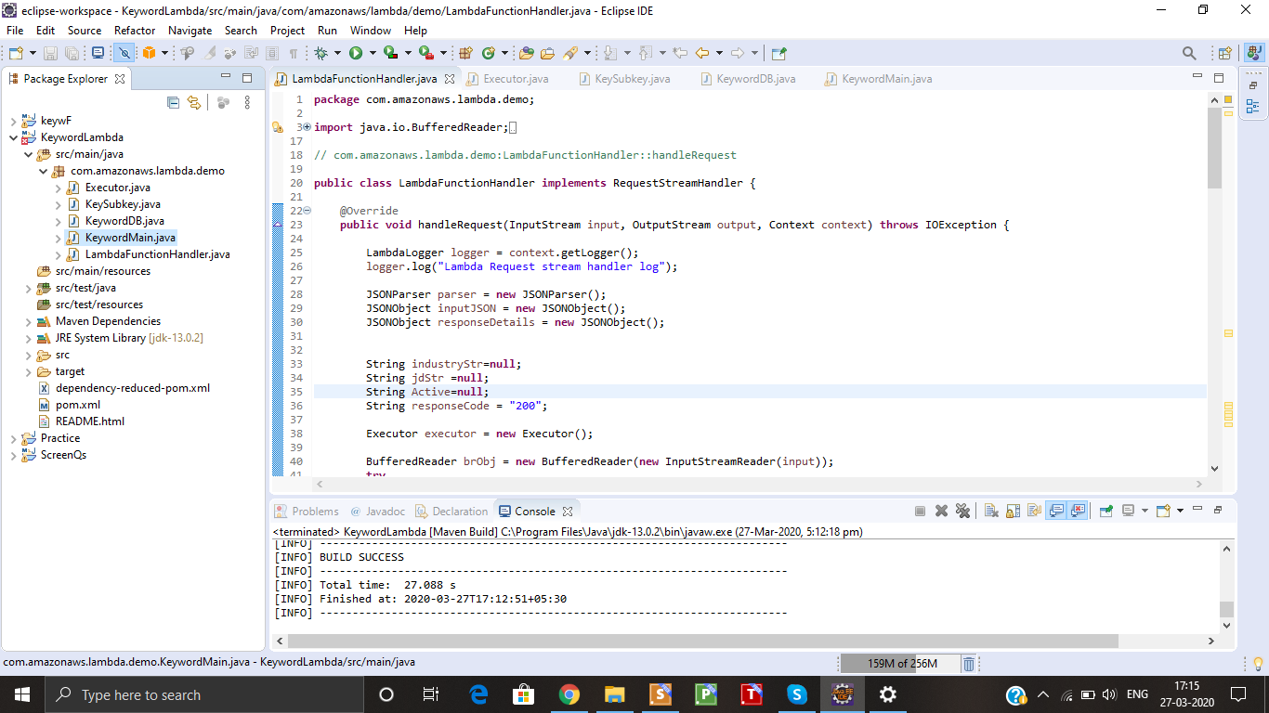
AWS Lambda project on Eclipse

Slide 9
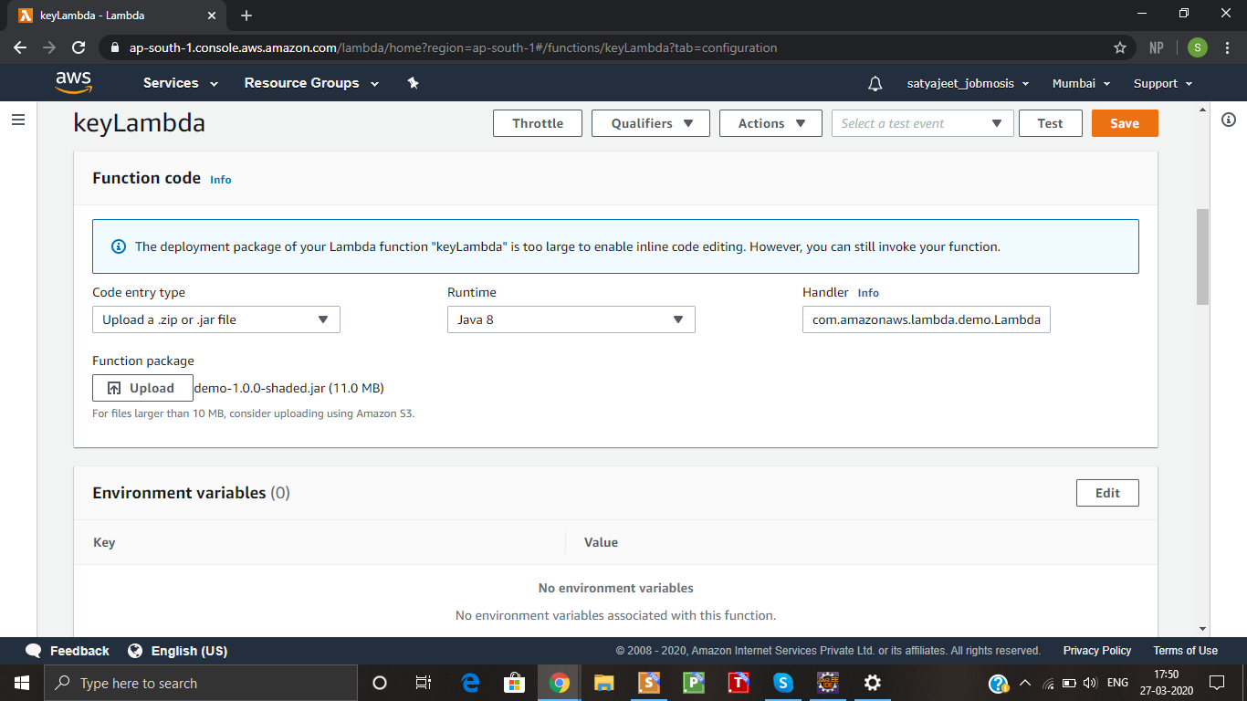
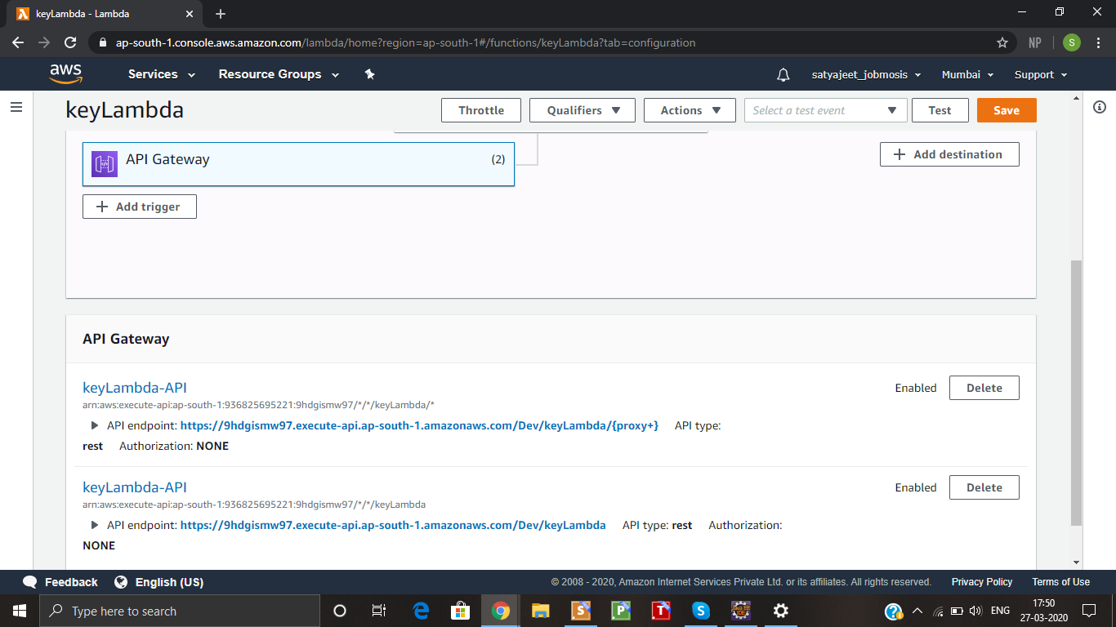
AWS Lambda

Slide 10
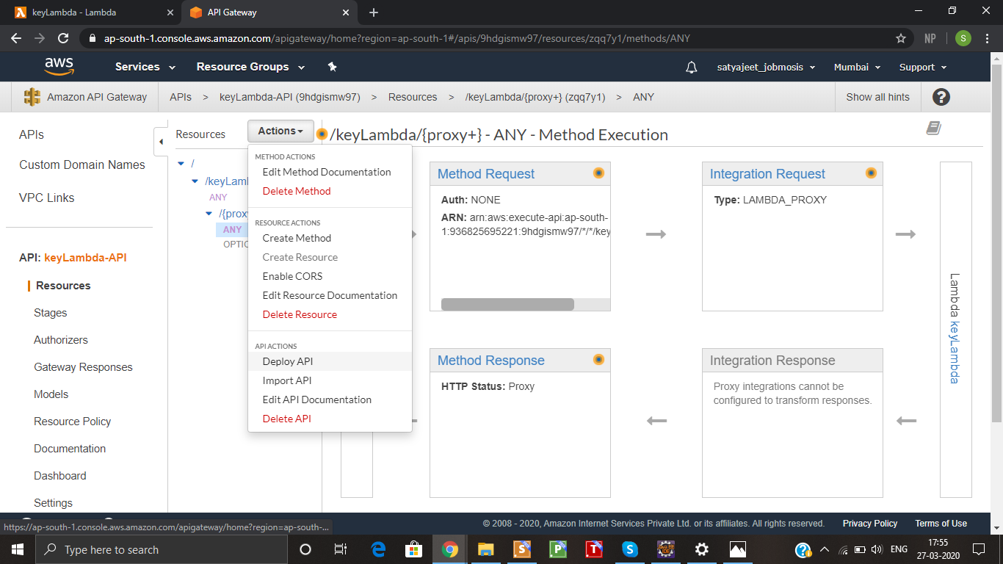
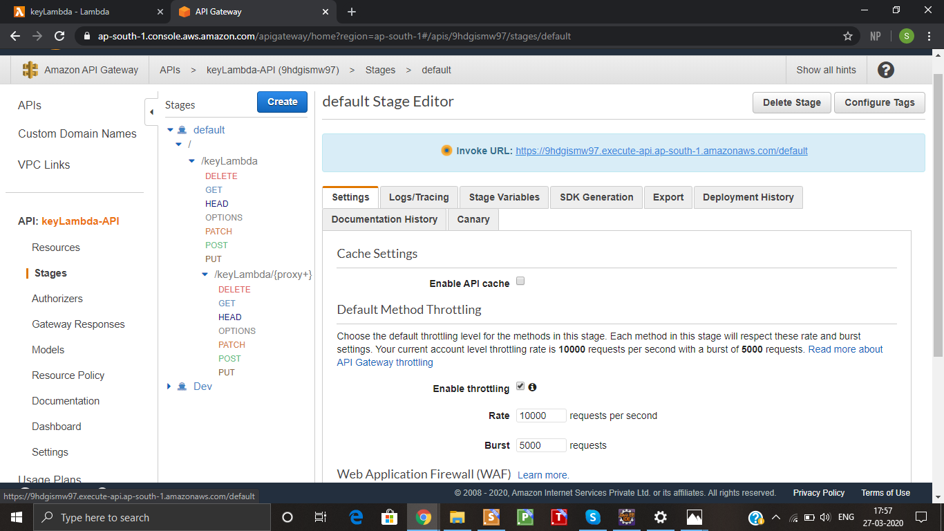
API deployment

Slide 11
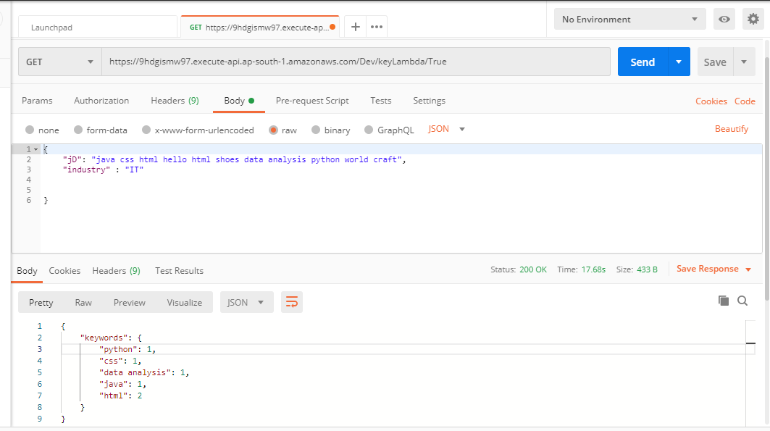
Output on Postman

Slide 12
Methodology Followed
For employee login system :
Java project on Eclipse for implementation
javax.swing package from java for user interface
Java programming and MySQL for backend
database created using MySQL Workbench of MySQL Server
database connected to backend by JDBC

Slide 13
Methodology Followed
executed on Eclipse IDE
Main components of login system :
Login page
Admin home page
User home page

Slide 14
Login page working
main page of system
select the login for either the admin or a user
enter username and password
for admin -
username is set as “admin”
password is set by default
opens admin home page if correct password is entered

Slide 15
Login page working
for user -
username has to be existing and password must match with it to login successfully
opens user home page
reset button clears username and password textfields
exit button closes the application

Slide 16
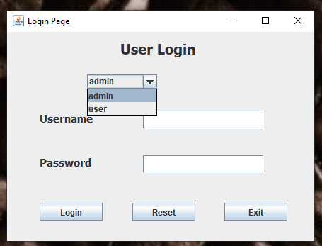
Login page

Slide 17
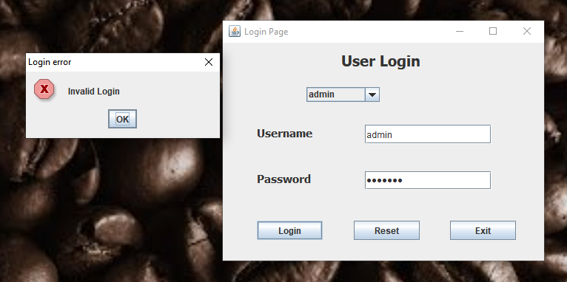
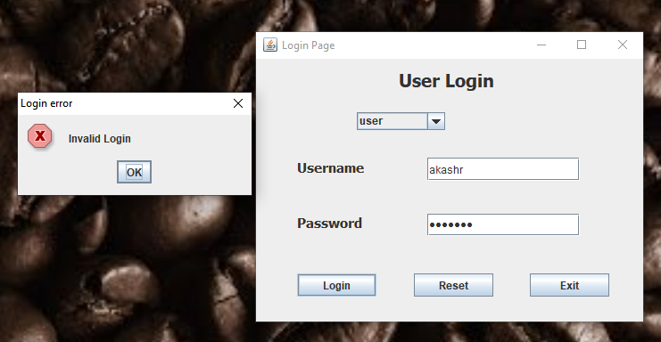
Error message for invalid login

Slide 18
Admin home page working
add new employee - fill all employee details and click on the button “Add new employee”
remove employee - provide the employee ID and click “Remove employee” button
update performance fields - provide the employee ID and “Performance review” and “Rating” fields, then click on “Update performance review/rating” button
view the list of employees - click on “View employee list” button

Slide 19
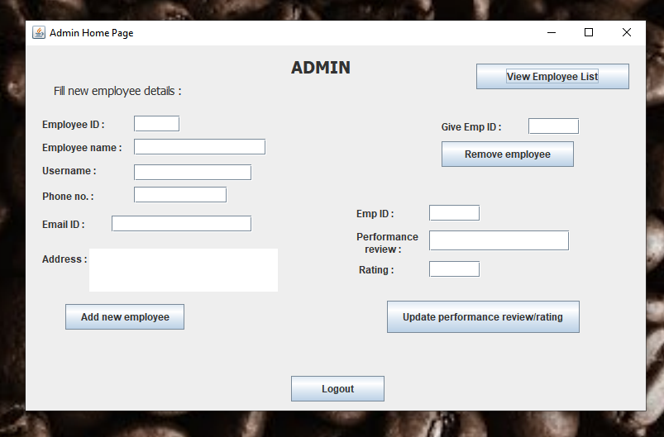
Admin home page

Slide 20
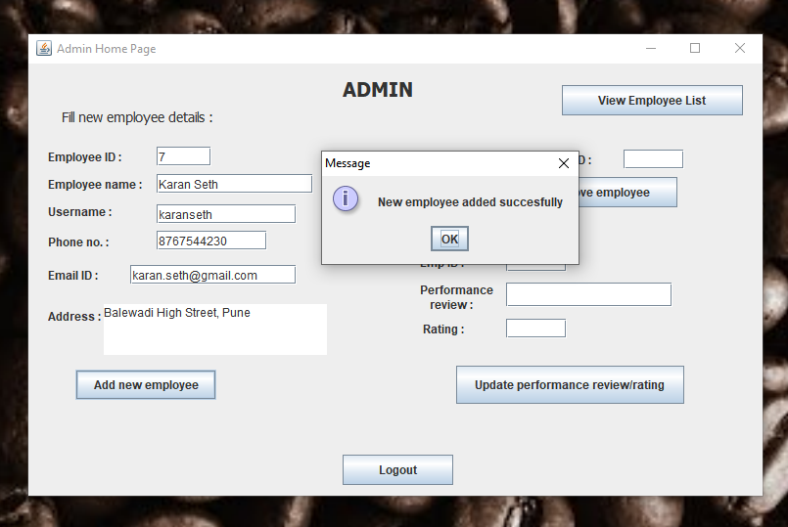
Add new employee

Slide 21
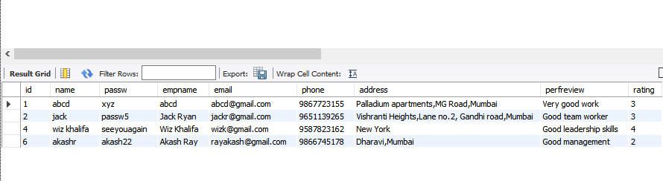
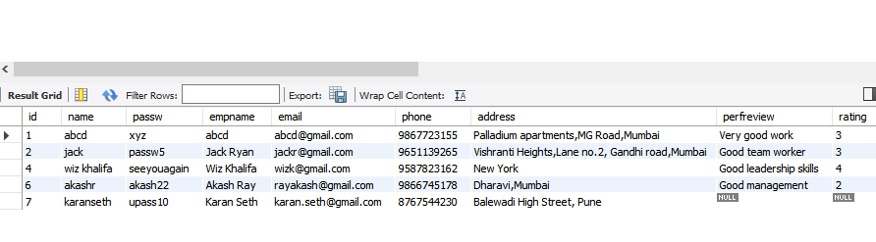
Current database
Database after adding new employee

Slide 22
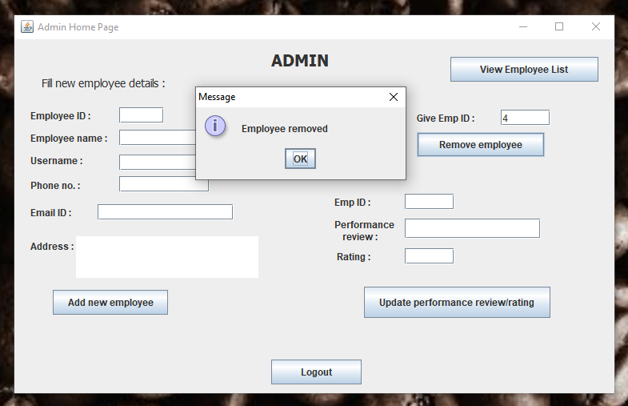
Remove employee

Slide 23
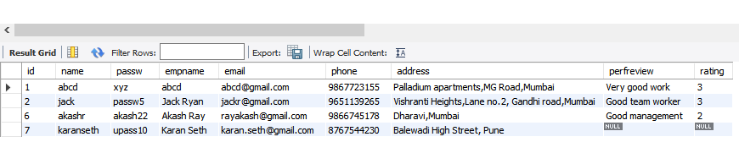
Current database
Database after removing employee with ID=4

Slide 24
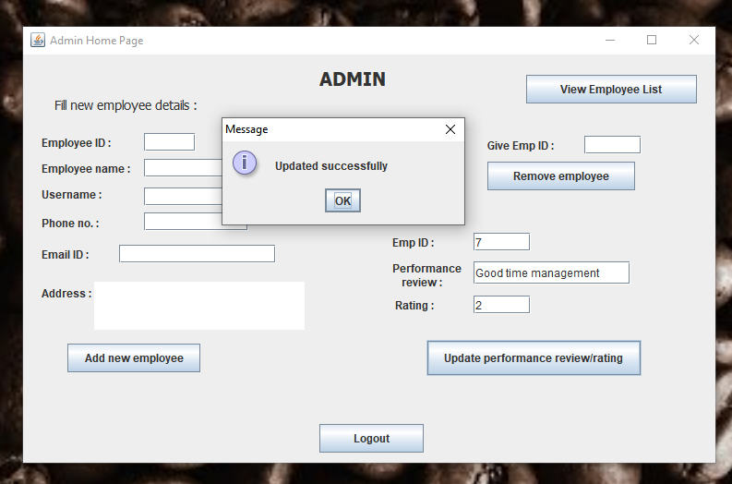
Update performance review/rating

Slide 25
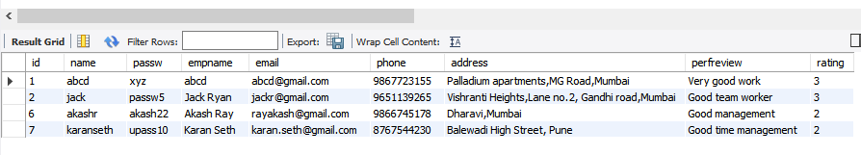
Current database
Database after updating performance fields of employee with ID=7

Slide 26
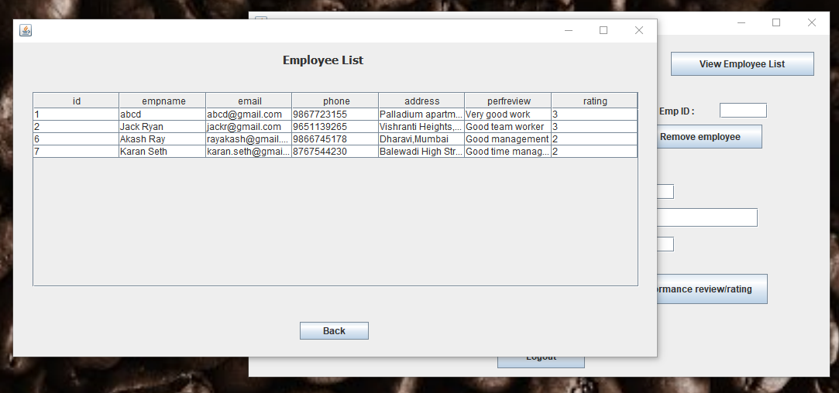
View employee list

Slide 27
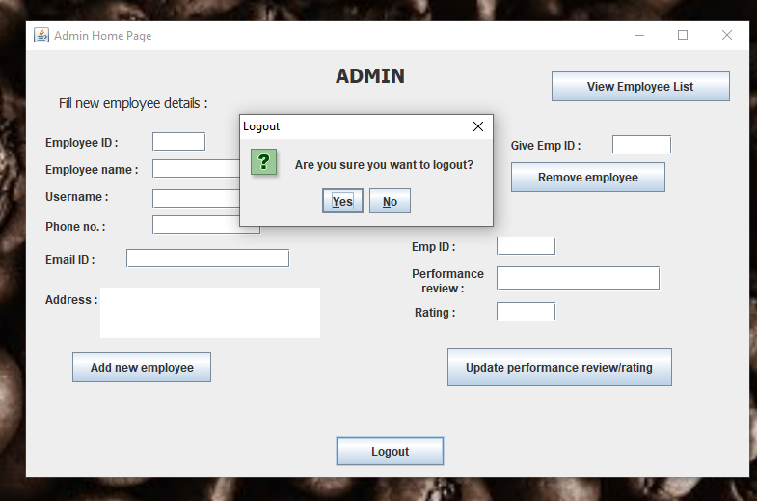
Logout

Slide 28
User home page working
employee details displayed - employee ID,name,email ID,address, phone number,performance review and rating
update details - provide phone number/email ID/ address and click on “Update info” button
change the password - provide new password and click on button “Change password”

Slide 29
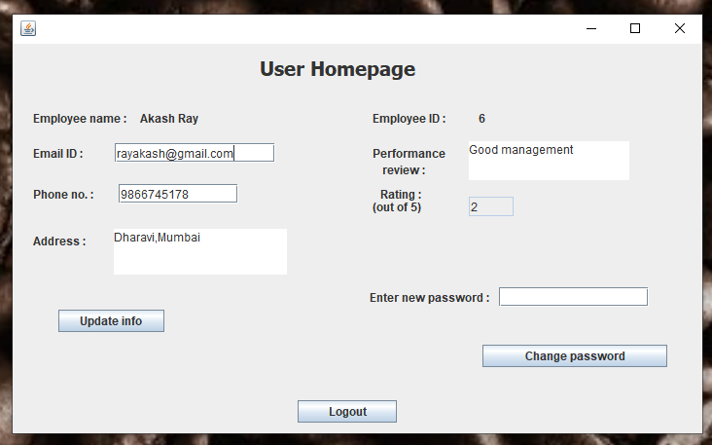
User home page

Slide 30
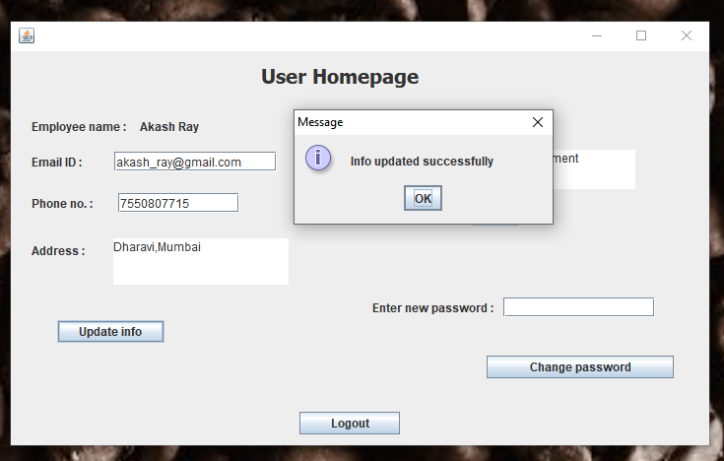
Update information

Slide 31
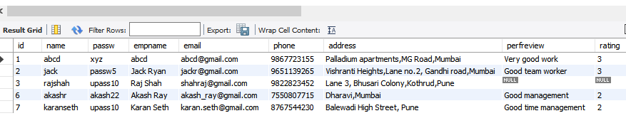
Current database
Database after updating info of employee with ID=6

Slide 32
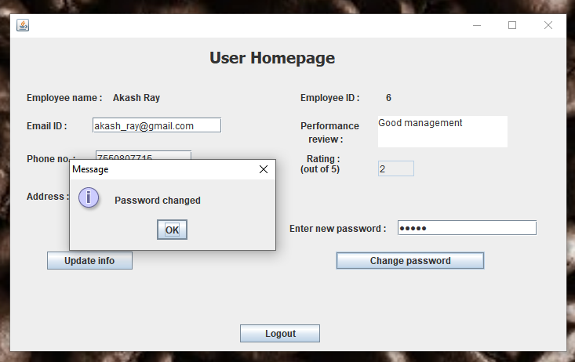
Change password

Slide 33
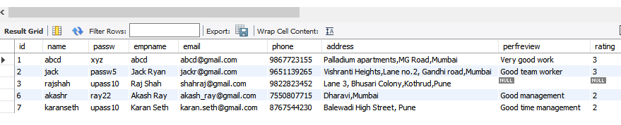
Current database
Database after updating info of employee with ID=6

Slide 34
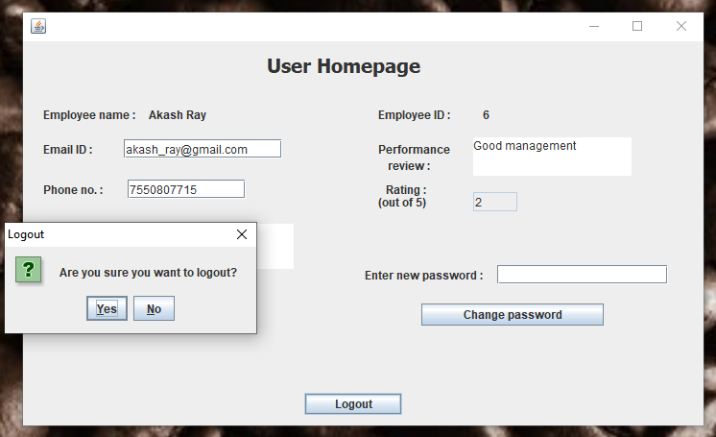
Logout

Slide 35
Conclusions/Findings/Observations
AWS provides various useful services for software applications
Some dependencies are necessary to be added to java project for some functionalities
APIs are very useful for the developer of the application as well as others who get it’s access

Slide 36
Conclusions/Findings/Observations
Object oriented programming provides code reuse and increases efficiency of the program
Data and text mining can be effectively used for developing efficient and time-saving software, and get desired results with high accuracy
Databases and their management play a crucial role in a majority of software applications and systems

Slide 37
Key Learnings
Java basics (syntax and programming basics)
Object Oriented Programming in Java
Using Eclipse for Java programming
JDBC for backend
New concepts like Hashmaps, Arraylists, JSON Objects
Using DBVisualizer to access database

Slide 38
Key Learnings
AWS lambda project
Using AWS Lambda for deploying API
Using Postman to test output using API endpoint
Creating and manipulating database using MySQL on MySQL Server
Creating UI using java swing

Slide 39
Thank you

